Slide 1
Hackathon Submission
By:
Tsz Fung Hu (David) &
Priya Panwar

Slide 2
Approach
Problem Statement – what is the optimized digital customer journey (users’ actions) before purchase
Data - Website (ford.ca) clickstream data - buying and engagement actions
Time Period - April 2020 to April 2022
Data Preprocessing – Cleansing and EDA
Analysis – Multivariate :
Principal Component Analysis
Structural Equation Modeling
Programming – Python (semopy)

Slide 3
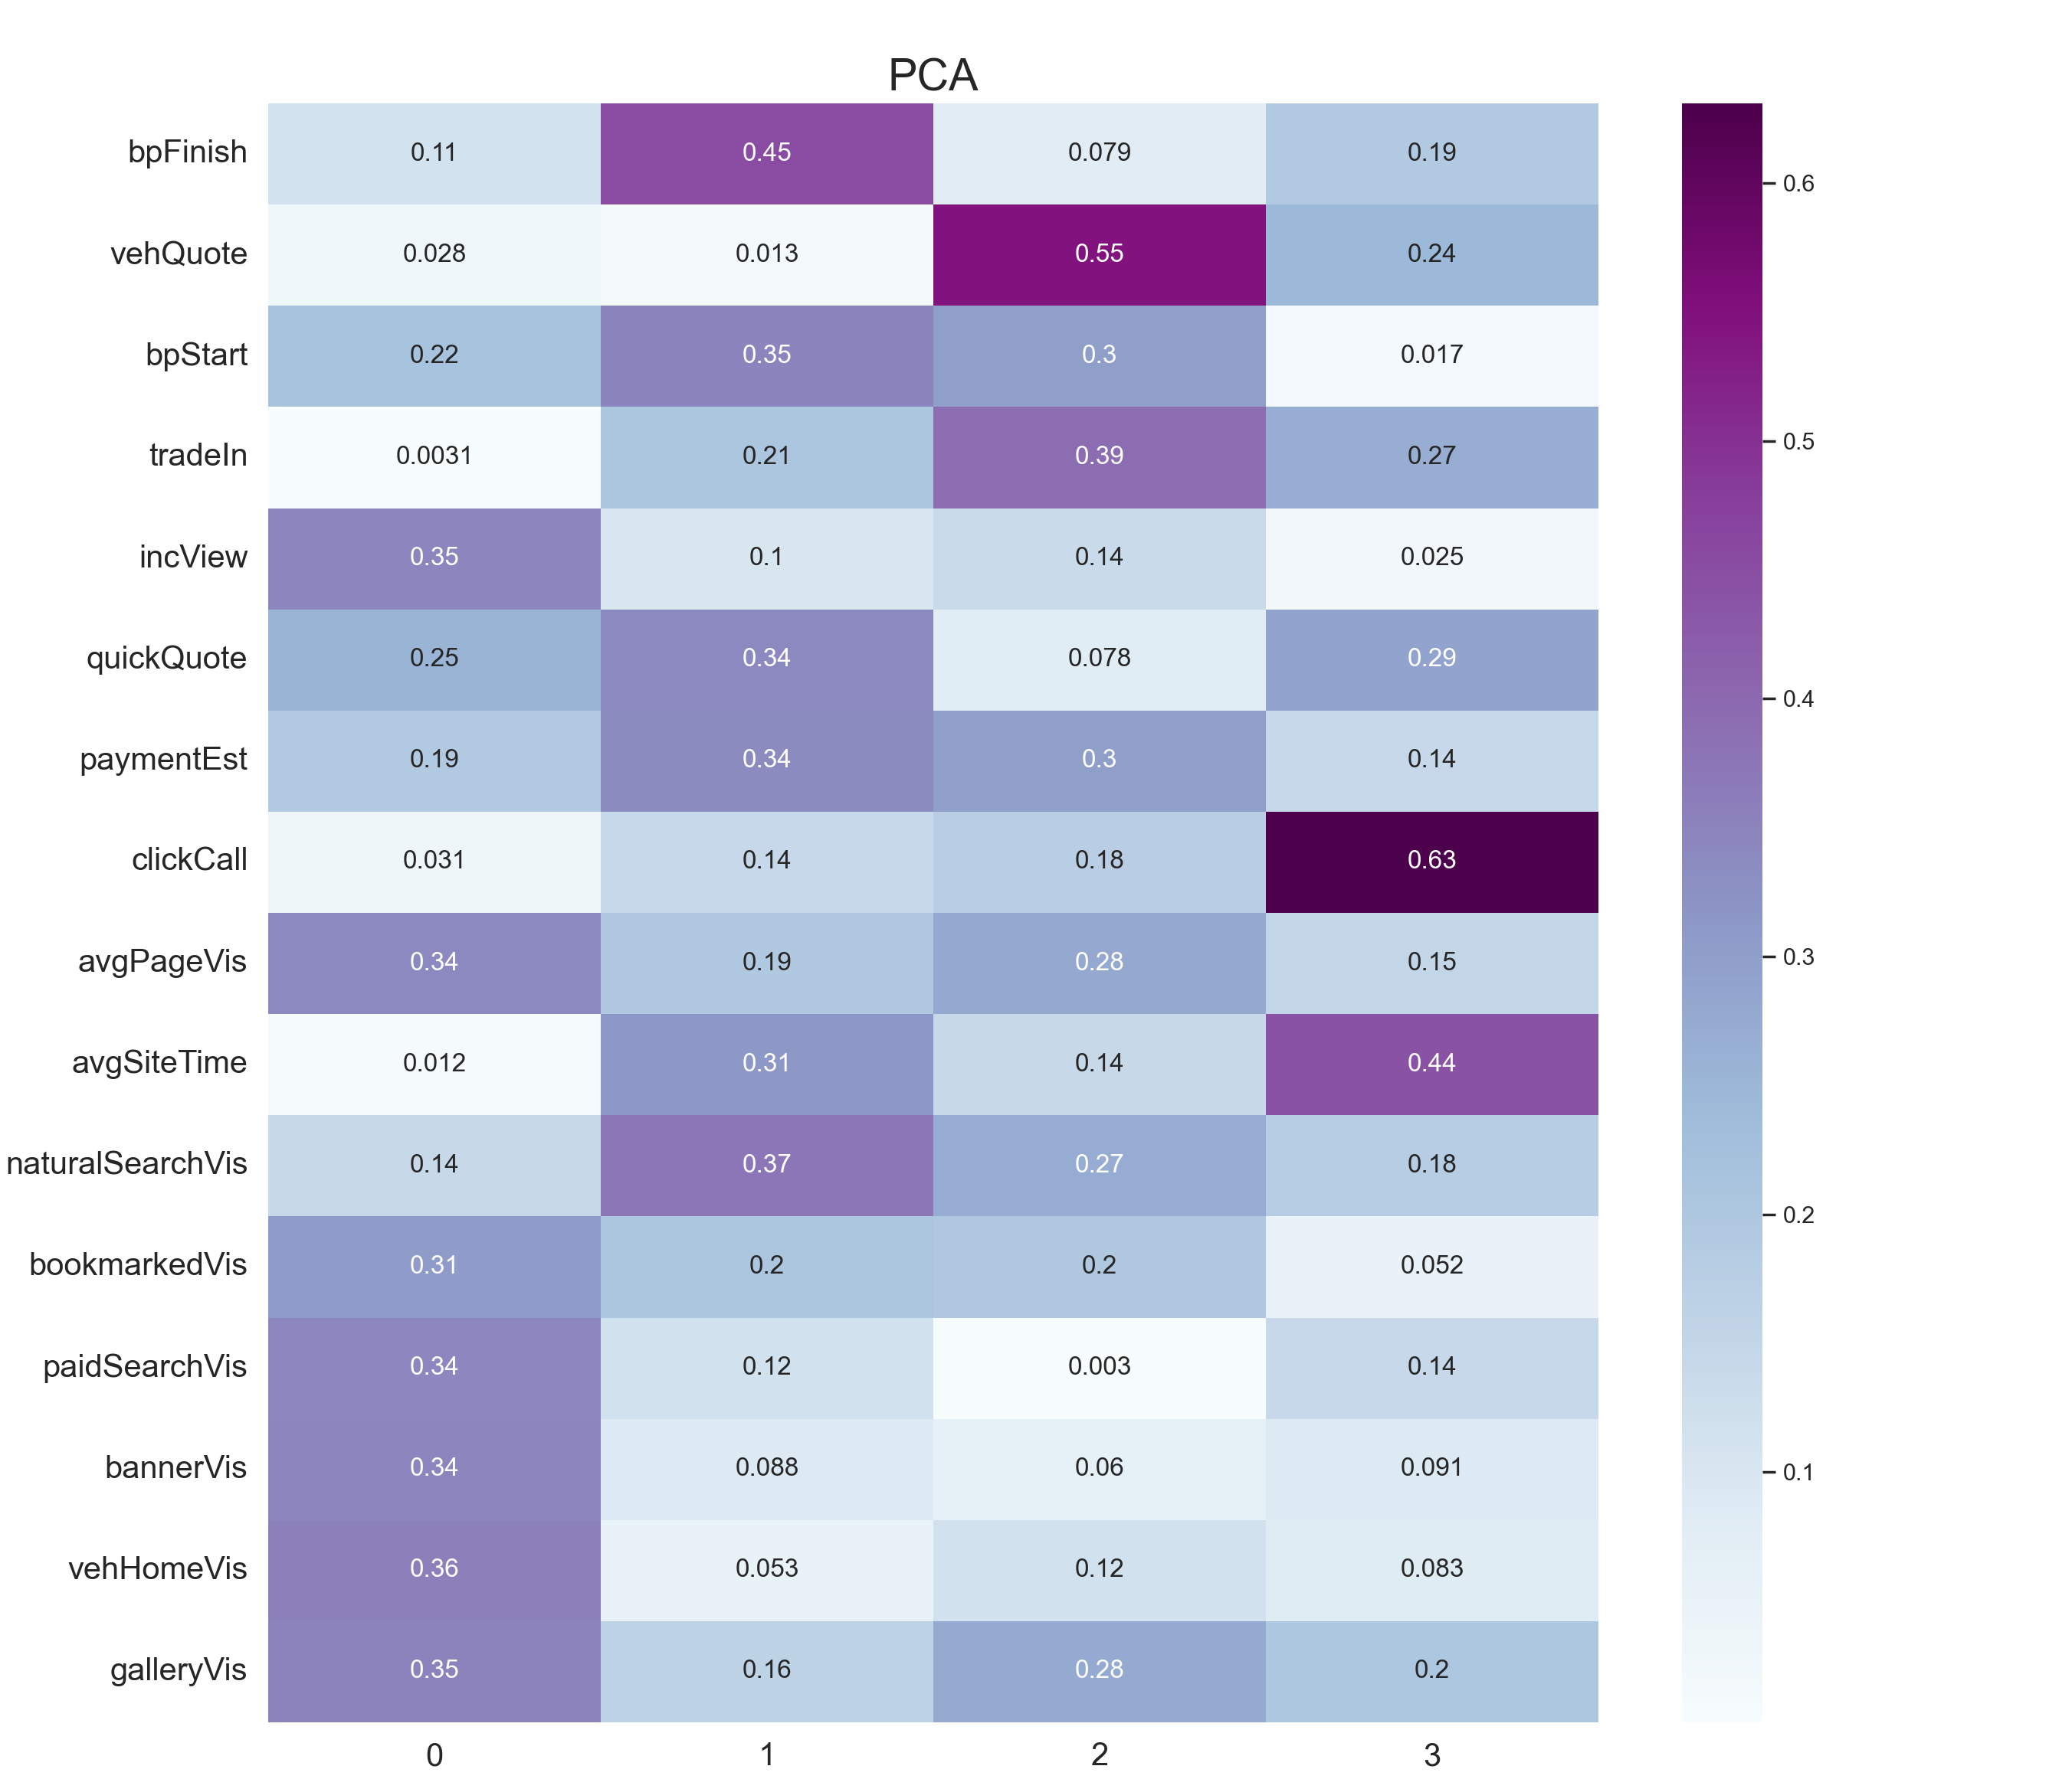
PCA
0- Passive
1- Aware
2- Explore
3- Consider

Slide 4
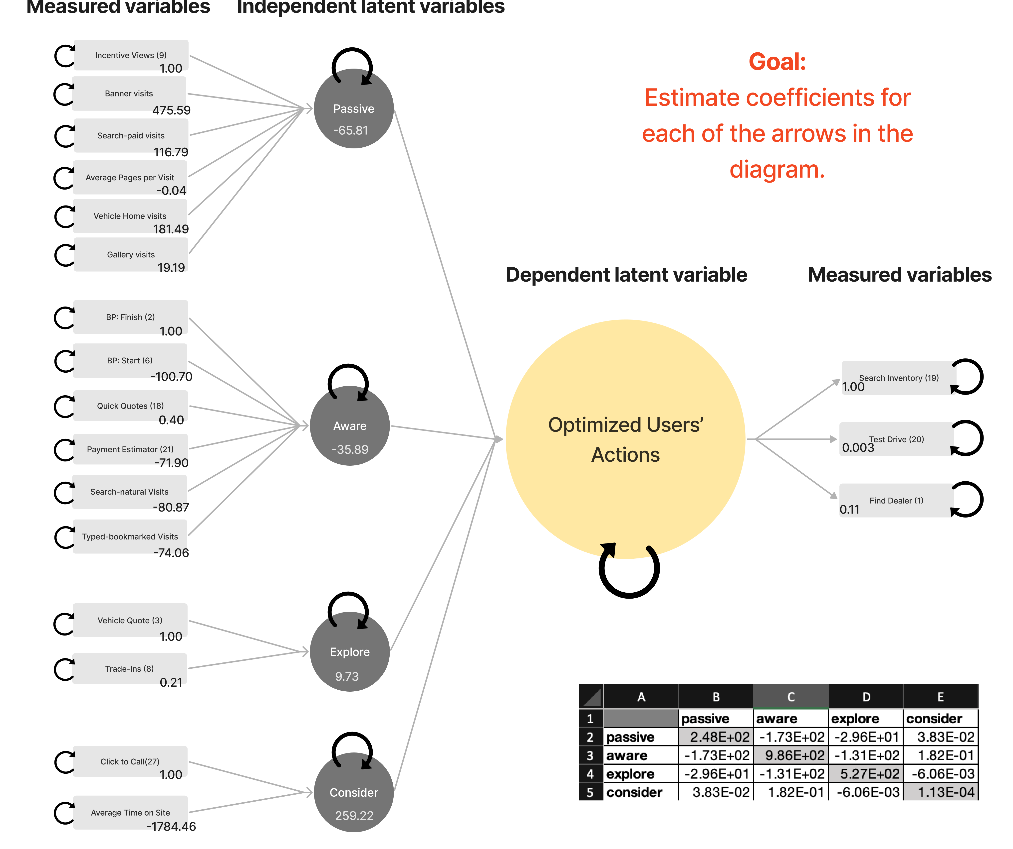
Customer Journey

